Slide 1
Canada’s
Economy
Economic System &
Factors of Economic Growth

Slide 2
Standards
SS6E1 The student will analyze different economic systems.
a. Compare how traditional, command, and market, economies answer the economic questions of 1-what to produce, 2-how to produce, and 3-for whom to produce.
b. Explain how most countries have a mixed economy located on a continuum between pure market and pure command.
c. Compare and contrast the basic types of economic systems found in Canada*, Cuba, and Brazil.
*This file focuses on Canada only. Cuba & Brazil are in my “Comparing Latin American Economies” file.

Slide 3
Canada’s
Economy
Economic System &
Factors of Economic Growth

Slide 4
Let’s Review
Economic Systems
Do you remember the three questions that every country must answer when developing its economic plan?
What goods/services will be produced?
How will goods/services be produced?
Who will consume the goods/services?
The way a country answers these questions determines what kind of economic system it will have:
Traditional Command Market

Slide 5
Traditional Economy
All economic decisions are based on customs, traditions, & beliefs of the past.
People will make what they always made & do the same things their parents did.
The exchange of goods is done through bartering.
Bartering = trading without using money
Some examples: villages in Africa & South America, the Inuit in Canada, Aborigines in Australia

Slide 6
Command Economy
All economic decisions are made by the Government.
The government owns most of the property, sets the prices of goods, determines the wages of workers, plans what will be made…everything.
This system has not been very successful. More and more countries are abandoning it.
This system is very harsh to live under; because of this, there are no PURE command countries in the world today.
Some countries are close: Cuba, former Soviet Union, North Korea, former East Germany, etc.
All of these countries have the same type of government: Communist! The government is in control of everything.

Slide 7
Market Economy
Economic decisions are made based on the changes in prices that occur as buyers & sellers interact in the market place.
The government has no control over the economy; private citizens answer all economic questions.
In a truly free market economy, the government would not be involved at all. Scary…
There would be no laws to make sure goods/services were safe. *Food! Medicine!
There would be no laws to protect workers from unfair bosses.
Because of this, there are no PURE market economies, but some countries are closer than others.
Some Examples: US, UK, Australia, etc.

Slide 8
Hmmm…
Since there are no countries that are purely command or purely market, what does that make them?
Most democratic countries have some characteristics of both systems, so we keep it simple and call them: MIXED
Of course, most countries’ economies are closer to one type of system than another.

Slide 9
Let’s Review
Factors of Production
There are 4 factors of production that influence economic growth within a country:
Natural Resources available
Investment in Human Capital
Investment in Capital Goods
Entrepreneurship
The presence or absence of these 4 factors determine the country’s Gross Domestic Product (GDP) for the year.

Slide 10
Gross Domestic
Product
GDP is the total value of all the goods and services produced in that country in one year.
It measures how rich or poor a country is.
It shows if the country’s economy is getting better or worse.
Raising the GDP of a country can improve the country’s standard of living.

Slide 11
Natural Resources
“Gifts of Nature”
Natural resources are important to countries because without them, countries must import the resources they need (can be costly).
A country is better off if it can use its own resources to supply the needs of its people.
If a country has many natural resources, it can trade/sell them with other countries.

Slide 12
Capital Goods
To increase GDP, countries must invest in capital goods:
All of the factories, machines, technologies, buildings, and property needed by businesses to operate.
If a business is to be successful, it cannot let its equipment break down or have its buildings fall apart.
New technology can help a business produce more goods for a cheaper price.

Slide 13
Human Capital
To increase GDP, countries must invest in human capital.
Human capital is the knowledge and skills that make it possible for workers to earn a living producing goods and services.
This includes education, training, skills, and healthcare of the workers in a business or country.

Slide 14
Entrepreneurship
People who provide the money to start and operate a business are called entrepreneurs.
These people risk their own money and time because they believe their business ideas will make a profit.
Entrepreneurs must organize their businesses well for them to be successful .
They bring together natural, human, and capital resources to produce foods or services to be provided by their businesses.

Slide 15
Specialization
Not every country can produce all of the goods and services it needs.
Countries specialize in producing those goods and services they can provide best and most efficiently.
They look for others who may need these goods and services so they can sell their products.
The money earned by such sales then allows the purchase of goods and services the first county is unable to produce.
In international trade, no country can be completely self-sufficient (produce all the goods and services it needs).
Specialization creates a way to build a profitable economy and to earn money to buy items that cannot be made locally.

Slide 16
Canada’s Economy
Canada has a mixed economic system.
It’s actually pretty close to a Market economy; however, there is some government regulation among industries.
It does have “free enterprise”, which is competition between businesses.
Canada is economically strong.

Slide 17
Canada’s GDP
Canada’s GDP is $1.819 trillion (US dollars).
The GDP per capita (value of goods and services produced per person) is $43, 400.
This is a very high number; they are ranked 14th in the world!
Canada has such a high GDP because of the abundance of the four factors of economic growth within the country:
Natural Resources
Human Capital
Capital Goods
Entrepreneurship

Slide 18
Natural Resources
What are Canada’s major natural resources?
iron ore, nickel, zinc, copper, gold, lead, rare earth elements, molybdenum, potash, diamonds, silver, fish, timber, wildlife, coal, petroleum, natural gas, hydropower
The country's petroleum sector is rapidly growing with Alberta's oil reserves, ranking the country third in the world behind Saudi Arabia and Venezuela.
The sales of Canada’s natural resources bring in money from all over the world.

Slide 19
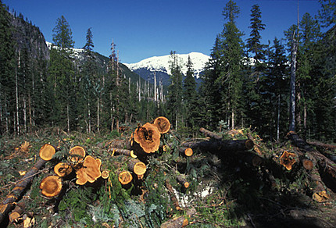
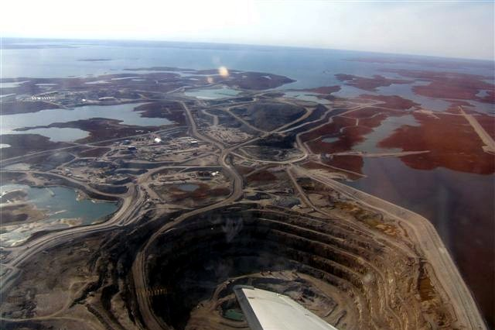
Diamond Mine
Timber

Slide 20
Land Use
What percentage of the land is arable (capable of being farmed)?
4.3% (only in Southern Canada; Northern Canada’s terrain is permafrost)
This is actually a large amount, considering Canada is the world’s 2nd largest country.
What are the major agricultural products?
wheat, barley, oilseed, tobacco, fruits, vegetables, dairy products, fish, forest products

Slide 21
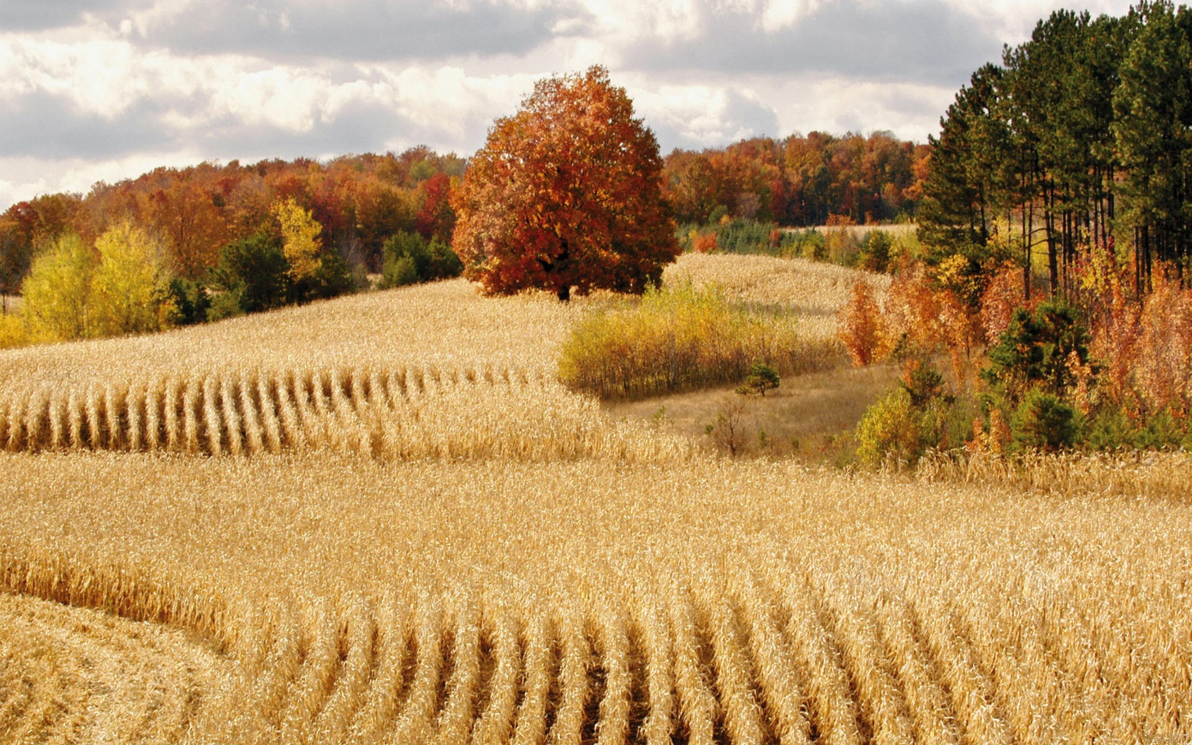
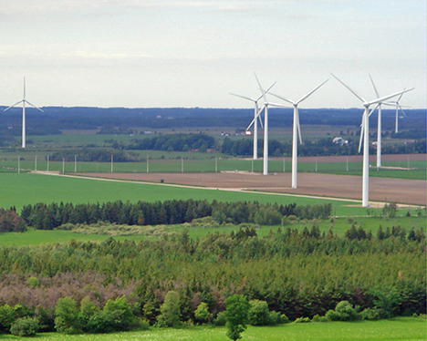

Slide 22
Industries
What’s produced in Canada’s factories?
transportation equipment, chemicals, processed and unprocessed minerals, food products, wood and paper products, fish products, petroleum, and natural gas
The service industry (helping someone) accounts for much of Canada’s economy – areas such as insurance, banking, retail, and tourism.

Slide 23
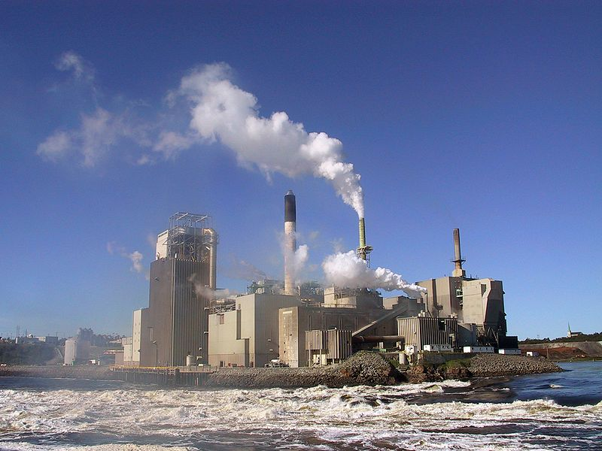
Pulp & Paper Factory

Slide 24
Specialization
Canada’s chief exports include:
motor vehicles and parts, industrial machinery, aircraft, telecommunications equipment, chemicals, plastics, fertilizers, wood pulp, timber, crude petroleum, natural gas, electricity, & aluminum
Nearly 75% of Canada’s exports are sold to the United States.

Slide 25
Economic Struggles
Unemployment & poverty
Over-depletion of natural resources
Acid rain from factories near Great Lakes region is destroying timber resources
Improving public services (which forces the country to raise taxes)

Slide 26
Unemployment Rate
What percentage of people do not have jobs?
7.3%
What percentage of people live in poverty?
9.4% can’t meet basic needs

Slide 27
Currency Exchange
Currency exchange is the price of one country’s currency compared to another.
1 US dollar = 1.04 Canadian dollars
1 US dollar = .74 EU euros
1 Canadian dollar = .71 EU euros
What does this mean?
The US economy is a little stronger than Canada’s; however, the economy of the European Union is stronger than both!

